Slide 1


Cloud-Based Digital Twin System for Smart Manufacturing Process Monitoring and Predictive Analytics
Guided By
Dr M D Boomija
Presented by:
N.R.YASASWINI (192425119)
FLORINA K (192521479)
VIJIYA PRIYA S.A (192524417) MALLIKA B (192324234)

Slide 2
INTRODUCTION
Modern factories use IoT sensors, cloud computing, and data analytics to improve production.
A Digital Twin is a virtual model of a physical machine or manufacturing process. It receives real-time data from machines and reflects their current condition.
Cloud computing provides scalable storage and remote monitoring capabilities.
Big Data Analytics processes large volumes of manufacturing data to identify patterns, improve efficiency, and support predictive maintenance.
The proposed system combines Digital Twin, Cloud, and Big Data Analytics to monitor
manufacturing processes and optimize production performance in real time.

Slide 3
LITERATURE SURVEY
Author & Year | Focus | Key Finding | Gap
Lee et al. (2024) | CPS & Industry 4.0 | Supports connected manufacturing. | Limited Digital Twin integration.
Kritzinger et al. (2024) | Digital Twin | Improves monitoring and efficiency. | Limited real-time analytics.
Qi & Tao (2025) | Digital Twin + Big Data | Enables data-driven manufacturing. | Cloud integration needed.
Tao et al. (2025) | Digital Twin | Supports monitoring and optimization. | Limited predictive maintenance.
Fuller et al. (2026) | Digital Twin | Reviews applications and challenges. | Scalability remains a challenge.

Slide 4
PROBLEM STATEMENT
Manufacturing machines are difficult to monitor continuously in real time. Unexpected machine failures cause production delays and downtime.
Traditional monitoring systems cannot efficiently process large volumes of sensor data.
Maintenance is usually performed after equipment failure occurs.
Lack of real-time analytics affects production efficiency and machine utilization. Industries need a cloud-based digital twin system for real-time monitoring, predictive maintenance, and process optimization.

Slide 5
OBJECTIVE
Collect real-time machine and sensor data from the manufacturing process. Create a
Digital Twin model to represent physical machines virtually.
Store and process data using Cloud Computing. Analyze production efficiency and machine utilization.
Apply Big Data Analytics to identify patterns and performance issues. Predict machine failures using Machine Learning techniques.
Display real-time insights through an Analytics Dashboard for better decision-making.

Slide 6
EXISTING SYSTEM
Traditional machine monitoring systems are widely used in manufacturing industries.
Machine and production data are collected manually or at periodic intervals. Existing systems provide only limited real-time visibility of manufacturing processes.
Maintenance activities are mostly performed after machine failures occur, causing downtime.
Large volumes of sensor and operational data cannot be analyzed efficiently for prediction and optimization

Slide 7
PROPOSED SYSTEM
Real-time machine and sensor data are continuously collected from the manufacturing process.
A Digital Twin model creates a virtual representation of physical machines and production systems.
Cloud computing is used to store, synchronize, and manage manufacturing data efficiently.
Big Data Analytics processes large-scale sensor data to identify trends, anomalies, and performance issues.
An Analytics Dashboard provides real-time monitoring, predictive maintenance alerts, and production optimization insights.

Slide 8
ALGORITHM USED
ALGORITHM USED – RANDOM FOREST
Random Forest is an ensemble Machine Learning algorithm based on multiple decision trees.
It uses different subsets of data and features to build several decision trees.
It is used in our system for fault prediction and machine performance forecasting.
It can handle large manufacturing datasets with multiple machine parameters.
Provides good accuracy, robustness, and reliability for predictive analysis.
The predictions can be used to reduce unexpected downtime and maintenance costs.
Technologies Used
Firebase Cloud: Real-time data storage, synchronization, and cloud-based machine data management.
Random Forest: Predictive analytics, fault detection, and machine performance prediction.
IoT Sensors: Collection of temperature, vibration, pressure, speed, energy, and machine-status data.
Digital Twin: Real-time virtual representation and synchronization of the physical manufacturing machine.

Slide 9
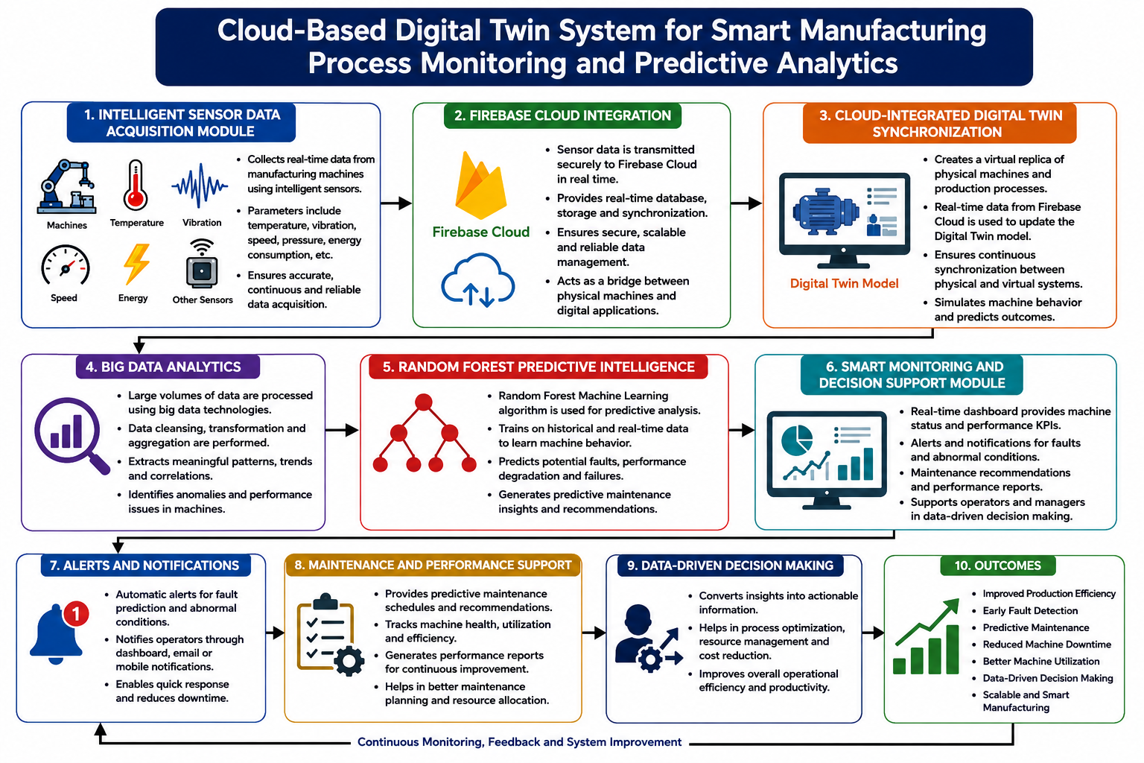
METHODOLOGY

Slide 10
MODULE 1
INTELLIGENT SENSOR DATA ACQUISITION
Collects real-time data from manufacturing machines and IoT sensors.
Captures temperature, vibration, machine speed, power consumption, and production information.
Monitors machine health and process conditions continuously.
Improves data accuracy through automated sensor-based data collection.
Provides reliable data for cloud processing, digital twin modeling, analytics, and predictive maintenance.

Slide 11
MODULE 2
Creates a virtual replica of manufacturing machines and production processes.
Synchronizes real-time sensor data with the digital twin continuously.
Simulates machine behavior and operational conditions for better analysis.
Tracks machine performance, status, and process changes in real time.
Supports process optimization, monitoring, and predictive maintenance using cloud integration.
CLOUD-INTEGRATED DIGITAL TWIN SYNCHRONIZATION

Slide 12
MODULE 3
BIG DATA ANALYTICS AND PREDICTIVE INTELLIGENCE
Processes large-scale manufacturing data using Apache Spark for efficient analysis.
Performs production trend analysis and machine performance evaluation continuously.
Detects anomalies and abnormal machine behavior automatically from sensor data.
Applies Machine Learning algorithms for predictive maintenance and failure analysis.
Predicts equipment failures and supports maintenance planning to reduce unexpected downtime.

Slide 13
MODULE 4
SMART MONITORING AND DECISION SUPPORT
Displays real-time machine status and production performance through a dashboard.
Monitors machine utilization, production output, and energy consumption continuously.
Generates automatic alerts for faults, overheating, and abnormal machine conditions.
Provides maintenance notifications and performance reports for operators and managers.
Supports faster decision making, production optimization, and better resource utilization.

Slide 14
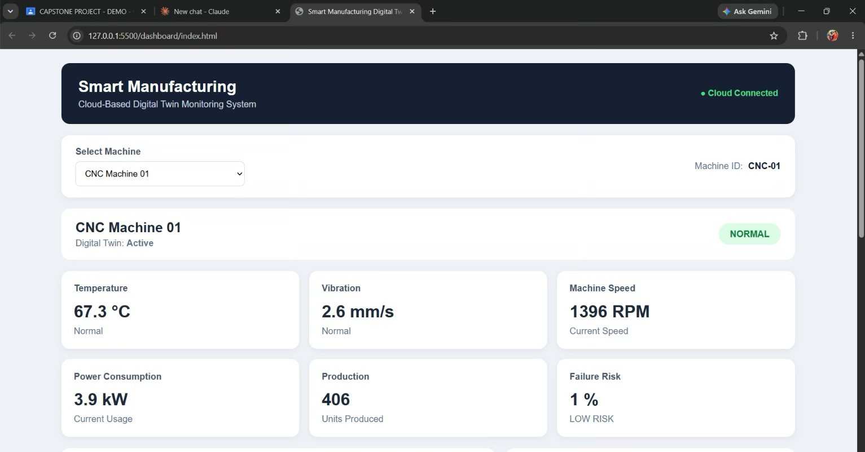
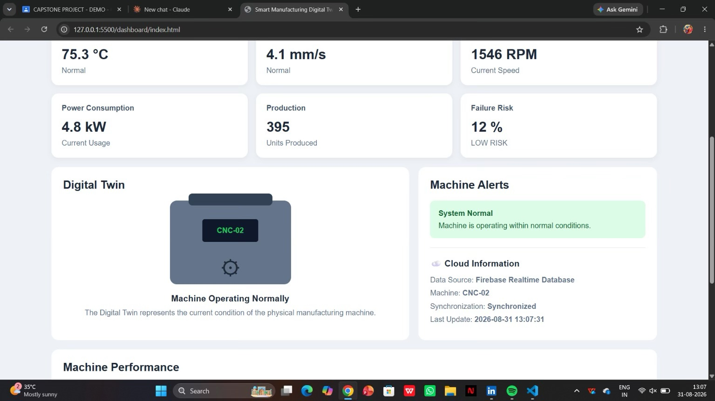
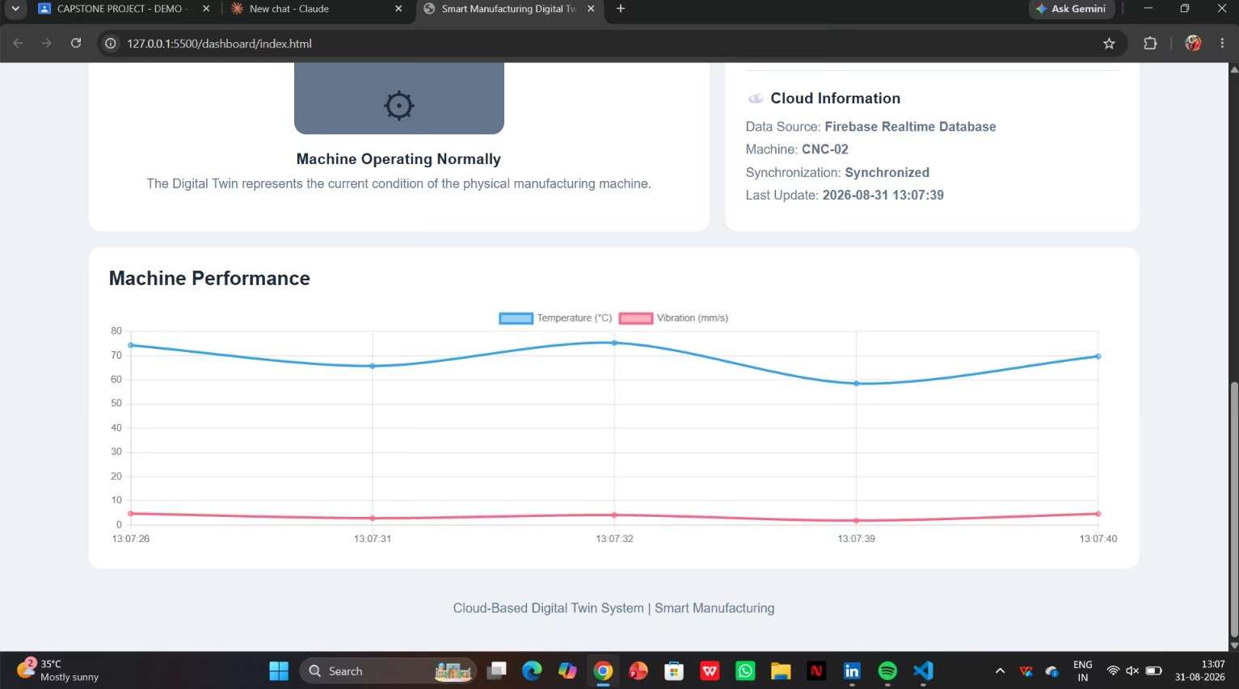
IMPLEMENTATION

Slide 15
CONCLUSION
Integrates IoT, cloud computing, big data analytics, and machine learning for smart manufacturing.
Enables real-time monitoring of machines and production processes through digital twin synchronization.
Improves production efficiency, machine utilization, and operational visibility. Predictive analytics helps reduce machine failures, downtime, and maintenance costs. Provides a scalable and efficient solution for Industry 4.0 manufacturing environments.

Slide 16
FUTURE SCOPE
Real-Time Monitoring: Improve real-time monitoring using IoT sensors and cloud technology.
Predictive Maintenance: Use advanced AI/ML models to predict machine failures accurately.
Process Optimization: Optimize production processes using digital twin simulations.
Energy Efficiency: Monitor and reduce energy consumption in manufacturing.
Cloud Scalability: Extend the system to support multiple machines and production units.
AI-Based Decisions: Enable automated fault detection and intelligent decision-making.

Slide 17
REFERENCES
Lee et al. (2024) – Focused on Cyber-Physical Systems (CPS) and Industry 4.0, highlighting the importance of connected and intelligent manufacturing systems.
Kritzinger et al. (2024) – Studied Digital Twin technology and showed its potential for improving real-time machine monitoring and overall manufacturing efficiency.
Qi & Tao (2025) – Explored the combination of Digital Twins and Big Data, supporting data-driven manufacturing and improved analysis of industrial processes.
Tao et al. (2025) – Investigated Digital Twin applications for manufacturing monitoring and optimization, helping improve operational performance.
Fuller et al. (2026) – Reviewed Digital Twin applications and challenges, highlighting issues such as scalability and the need for effective implementation in smart manufacturing.

Slide 18


